Slide 1
Narrative text generation
Story Generation using GPT-2 architecture by OpenAI
-D19033 [Varishu Pant]
-D19005 [Ankit Sekseria]

Slide 2
About the data
Text file contains chapters from George R.R. Martin’s book series-
Game of Thrones (A Song of Ice and Fire)
Size = 450 kb
Corpus Length=414584
Total Unique Words=9808
Total Unique Characters=40

Slide 3
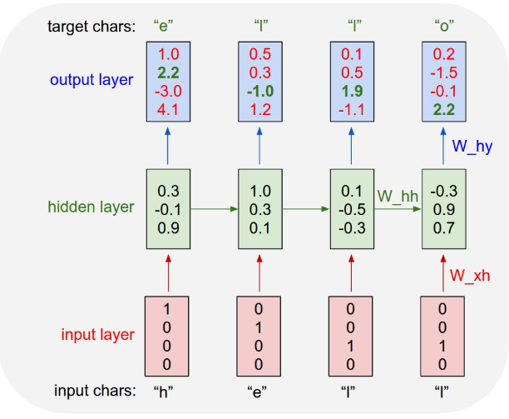

Character level (lstm)
Encode text and map each character to an integer and vice versa by creating 2 dictionaries-
Input- One hot encoded characters , converted into a column vector

Slide 4
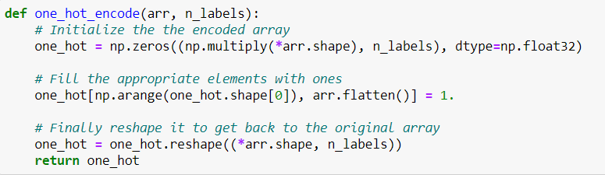
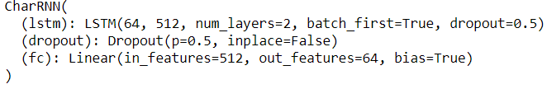
Function to One hot encode
Made Training Mini Batches
Set 128 sequences per mini batch with 100 character steps per sequence
Architecture built using PyTorch
512 Hidden Neurons
Optimizer set as Adam
Learning Rate=0.001
Validation Fraction=0.1
Gradient Clipping =5

Slide 5
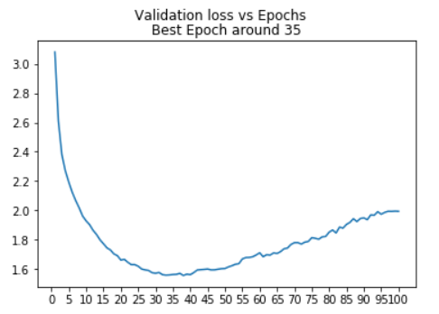
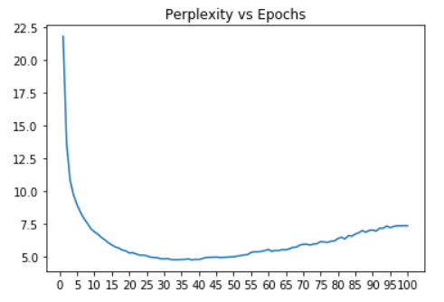
Evaluation
Best Epoch =38
Minimum Validation Loss=1.5533
Perplexity =4.727

Slide 6
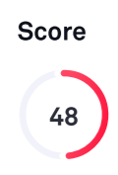
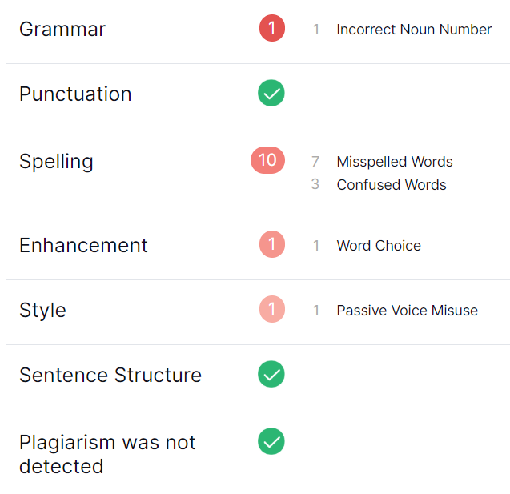
Sample text
Sample 1: [Top K =3]
Lannister and the stanter the silver of the breathers of the rider of that wanted to he will batter than the cold with a side, but the moment sawed his feat as the mome tabe and the child of he stood the boys were said of all a side. The seaters was a smile. I want the bastard that was the back of his beat. Jon said a moment began to comprething. The sing is not a man of the Winterfell to the king.  He said and shared his hands to the seven was all a seady of stangers and the streetthing walks
No. of Writing Issues =13

Slide 7
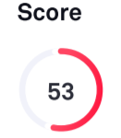
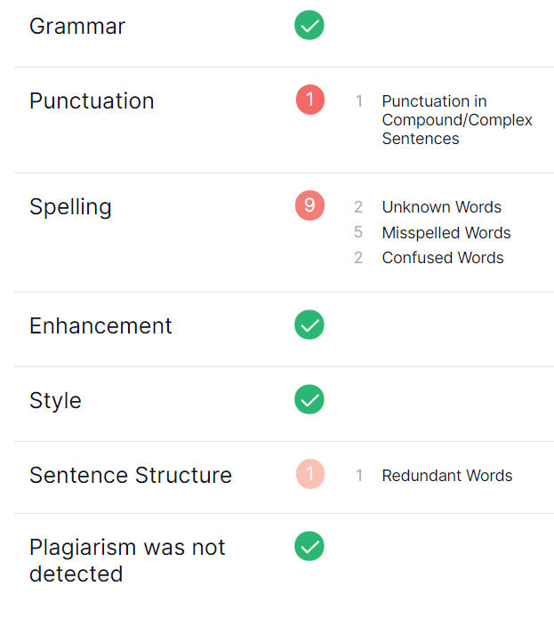
Sample 2: Top K=4
Lannister.  Then is the came towers of the Stark. I have thein monter to that manter, after the boy things and bested a strange out,  Jon seated as sharp. She was thriel besed her bringer into the strong of the sheet, the commands had seen out, and the brother standed was a what of shight to bride him as a fach and stone shouts and horses, and he dods.  I want to dee him that is it,  Ned replied.
No. of writing issues =11

Slide 8
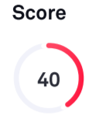
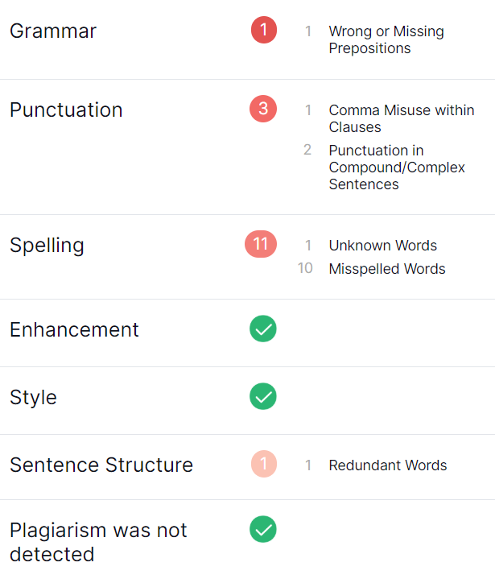
Sample 3: Top K=5
Lannister on the raiters, to his father had been busiled and set once thought his face was fation of brother's.A how, that she was afraid of the grace by the stope starith a can of him of his farithing. Howel. It were not been his feet. The king should have talked him another. He could see her fine had children, the sighly was he warming. The morniggts had spocted out the conowed and she was a shonly against the bottle togather asked him.
No. of Writing Isuues = 16

Slide 9
CHARACTER LEVEL (RNN)
Vectorized Text
Sequence Length=100
Examples per epoch=4104
Batch Size=64
Learning Rate=0.001
Optimizer=Adam
Buffer Size=10000 (to shuffle the dataset) [TF data is designed to work with possibly infinite sequences, so it doesn't attempt to shuffle the entire sequence in memory. Instead , it maintains a buffer in which it shuffles elements]
Embedding Layers:The input layer. A trainable lookup table that will map the numbers of each character to a vector with 256 dimensions
1024 RNN Units

Slide 10
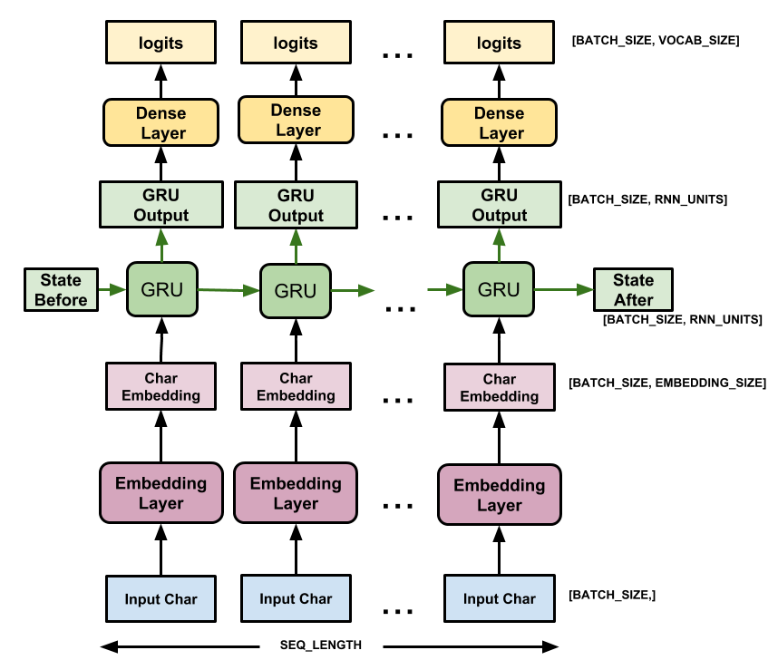

Slide 11
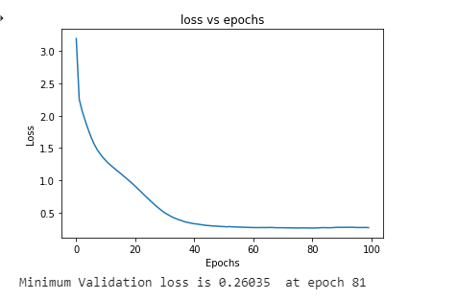
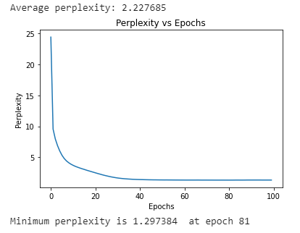
EVALUATION

Slide 12

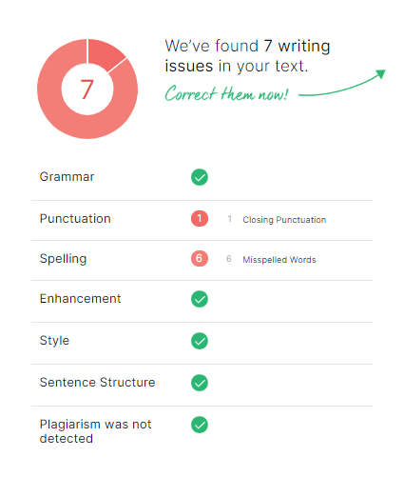
Sample text
Sample 1:Temperature 1.0
Lannister,  he said. And where is Arya usede him, gravelly, but Caster Eddard Stark man who was for usuall, a tew oiled men amone they were cruelp, and they had spentated from the river, running down at the empty clearing and laughed. Your sister. She knew the cay counsel you then for Lannisters. As the lived hand and pitched up before My betrothed. 
I can't fly,  Bran said. I can't, I countall and golden, within three yourself  He pulled a glove came back at the snow, beneath the streets, Da

Slide 13

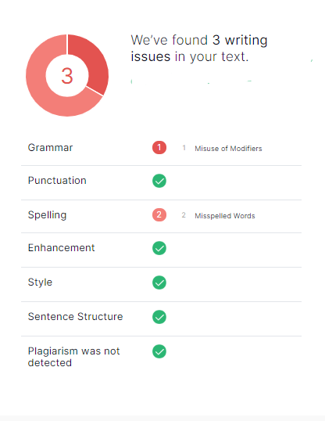
Sample 2:Temperature 0.6
Lannister, but they did not scare him. He'd be the first I've had to friend.  He pulled at his clothes like an insistent loomed as it had cleaned all the blood off her hand, it turned away silently and snow, walking silent again.
So deep in thoughtfully provided. A princess, she thought, but she said, Whatever you'd like to do, my prince. Jofftey reflection in the black pool, the septon was snoring softly, his head pillowed on an open book in front of him. Tyrion waited until the swinging had stoppe

Slide 14

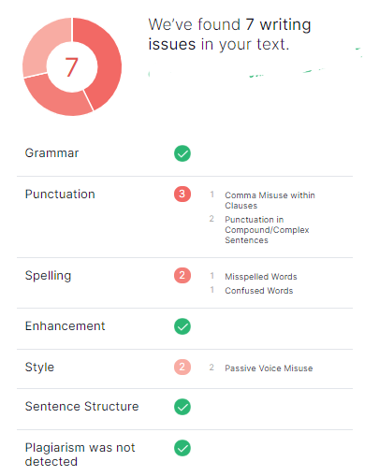
Temperature=0.25
Lannister, entered and lonely sound, full of melancholy and despair.
Do on, his brothers were forged of every metal known to man: black half a heavy does are read to your crypt, Eddard. I would pay mean,  Arya said.
You'll have to work at it every day.  He put the swords met on the broad plains of the Reach, amidst golden fields of wheat ripe for harvest. When it felt Bran whatever smelled his procession who hide,  Too shake. 
I cannot answer for the gods, Your Graceonly found her cheeks. Hungr

Slide 15
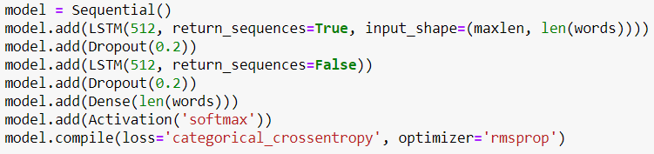
Sentence generation using Word-Level lstm model
Split words based on white space.
Normalize all words to lowercase to reduce the vocabulary size.
Sequence Length = 30
Step Size = 3
Total Sequences = 25991
Optimizer=RMSprop
After vectorization, we train a 2 stacked LSTM architecture

Slide 16
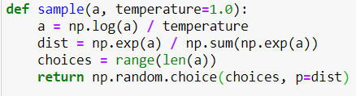
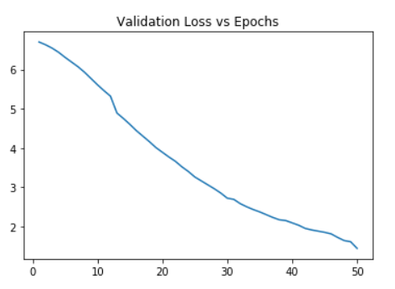
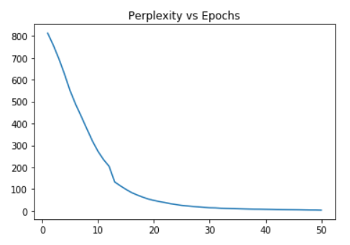
Evaluation
Trained for 50 epochs
Minimum Validation Loss=1.41
Perplexity=4.22

Slide 17

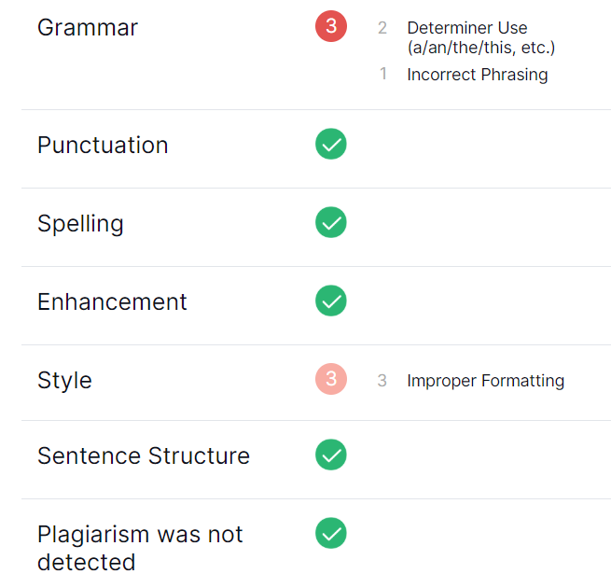
Sample text
Seed:at the door of eddard stark. yet ned could not help but notice that those pleasures were taking a toll on the king. robert was breathing heavily by the time
Temperature=0.5
Sample:
twenty reached way off on his hands for him by the house where that beyond up all, the lived out. ran until that bran just out all meet as front with nothing now, like asked as war little stark. but old door.
No. of writing issues:6

Slide 18
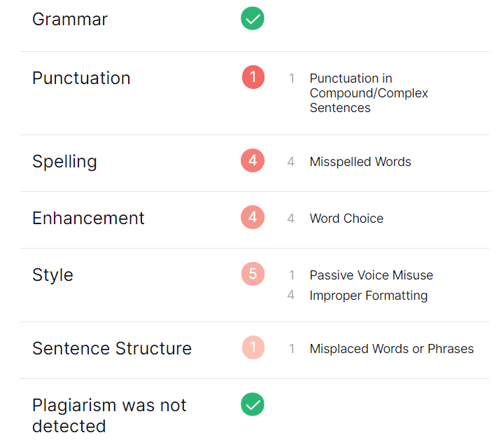
Temperature=1.0
Sample:
like up hard, let so jon's some shall them bran were remembered up it was found it strong that their good at was, and for eddard me winterfell might most come, but too big that admitted. there was lost cut men had, years or hear snow not them. he am her, stark best almost prince low than as his think watch there once very grand little strong young good that they viserys and his hands off, this stone. you nights narrow long send into the lady.
No. of writing issues:15

Slide 19
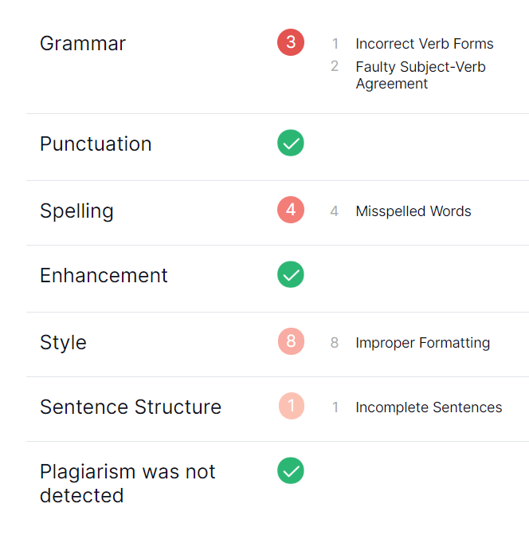

Temperature=1.2
Sample:
slid boy since aegon on a felt king's m'lady, but they was two well until they great bay hair and walls moved when the legs above its hear to gargoyle, their protect long off to his courtyard hard at him, now all sound. king Winterfell, as you. watched her eddard it need it could up ever us. so stark. is queen here.  she could one too time. at hear you're i'm almost just khal enough with your speak you help please, on her asked looked tell few might father too frightened came like for a window. it am word south sleep to new only need i did no very say.
No. of writing issues: 16

Slide 20
GPT-2 Architecture
There are three released sizes of GPT-2[Generative Pretraining Transformer]-
124M (default): the "small" model, 500MB on disk. [WE USED THIS ONE]
355M: the "medium" model, 1.5GB on disk.
774M: the "large" model, cannot currently be finetuned with Collaboratory but can be used to generate text from the pretrained model (see later in Notebook)
1558M: the "extra large", true model. Will not work if a K80 GPU is attached to the notebook. (like 774M, it cannot be finetuned).
Larger models have more knowledge, but take longer to finetune and longer to generate text.
Trained on 40 GB data scraped from the internet (called WebText)
Encoded text using Byte Pair Encoding
Algorithm learns on it’s own and is not supervised for any particular task [loss works to predict next word]
Still able to achieve State of the Art results in many language modelling tasks
Example- Translation, Summarization and Question Answering

Slide 21
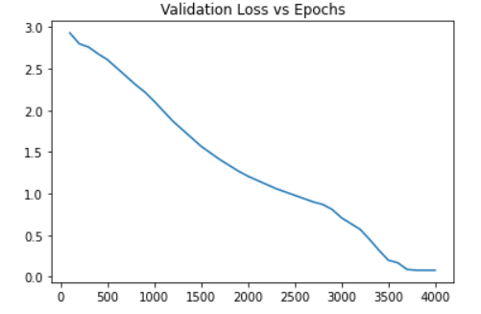
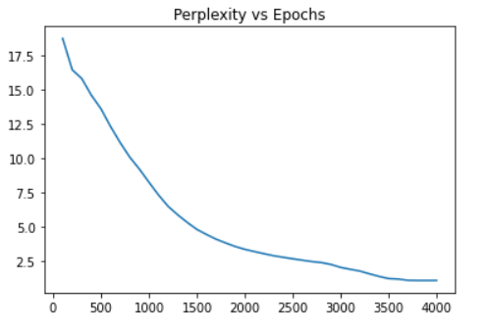
Finetuning on our dataset
Learning rate for the training. (default 1e-4, we lowered to 1e-5 because we have <1MB input data)
Our dataset has 103968 tokens
Trained for 4000 steps, but loss stabilized after 3700 steps
Minimum Validation Loss=0.08
Minimum Perplexity=1.083

Slide 22

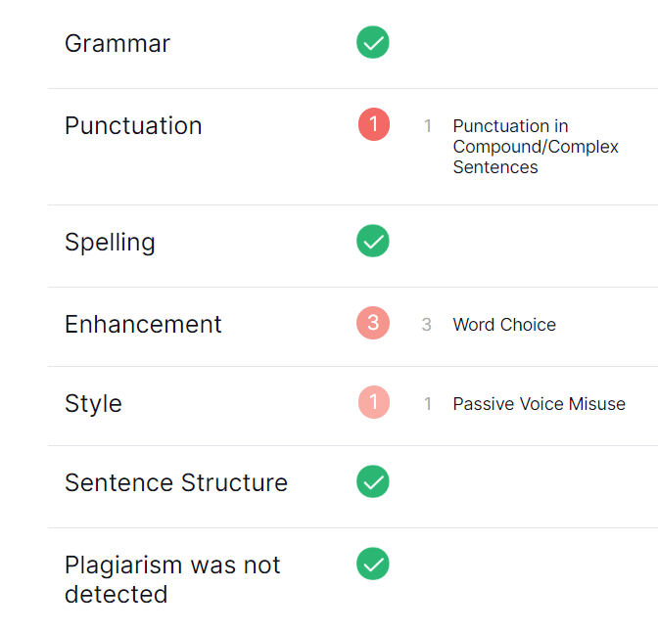
Sample text
Tuning Temperature with
Top_K=0 and Top_P[Nucleus Sampling]=0
Temperature=0.2
Lannister said, I don't think so. You're only a wolf, aren't you? Jon said, thinking how positively he looked at the feast day. He looked more like a giant in those early days, much like him. He was handsome and strong, yet somehow a little too handsome for his body, as if to give Jon his rightful place in the king's hall. Not anymore, Jon said. He wanted to be given back to the boy's world. Back that very moment he asked himself: Who has the right to his body? Be my brother's, Jon said. A question that will stay at the top of his lungs forever forever forever You were never born with my son, Royce said. I had a son with a pony at my table. He laughed. I had a daughter with a ponyboy. That wasn't my son, Jon said. An answer was in a word, but a third had not yet been given, and then more and more, and what was said were fierce words. They were Scarifs, said Jon, and he slammed the refocus back into place.

Slide 23

Temperature=0.5
Lannister said, You're a bastard, aren't you? Oh, yes, Lannister said, astonished. Lannister was a hard boy to have muss thrown at him. I have proof, Lannister. I will bring Robert to you. Jon did not seem amused. I would bring Robert to you myself, he said. Lannister looked to Stark for guidance. He is my brother's room physician. DAENERYS
Daenerys Targaryen looks forward to her time as Magister of Winterfell
Arya: What is it, Jon?
Jon: Catelyn.
Catelyn: Are you sure that will change our plans for Robert? Jon looked at her. We might all be at the end of the world. Or, he said. Who knows, we might all be alive! Her eyes moved to Daenerys. Magistery is too important to me. You are my wife, she told him. I am your blood sister. And you must take me with you when you go off to war.

Slide 24

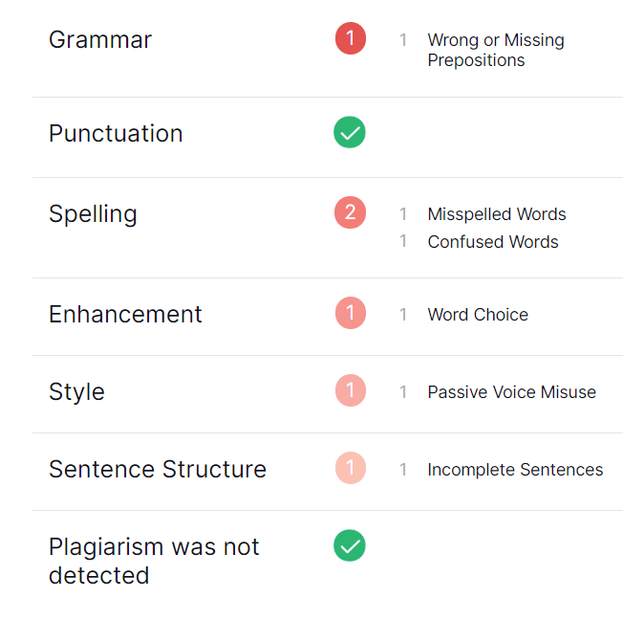
Temperature=0.8
Lannister? Tyrion glanced at him with the same expression on his once-distant face, then him staring eyes. The younger man kept his place beside a barrel of ale, his throat tight around the beer. The younger man leaned forward, looked at him patiently, then pulled the fat off his finger with a swift shove. The look on his man's man's lips was priceless. You weren't s'posed to be here, he muttered under his breath. Littlefinger was rolling with his breakfast partner as he began his morning instruction. Take him the first day. The next. The words came unbiddenly easy to him as he read them. Min Chronicles, l'Ange, l'Et (colloquiums were their place of honor, after all), l'Haut veriteurs, he said, halting beside them. Joffteur lent him the books on impatience, if that was so. Lord Renly assured him that Arya's hair would never be blond again, Eddard Stark would do well to know this.

Slide 25

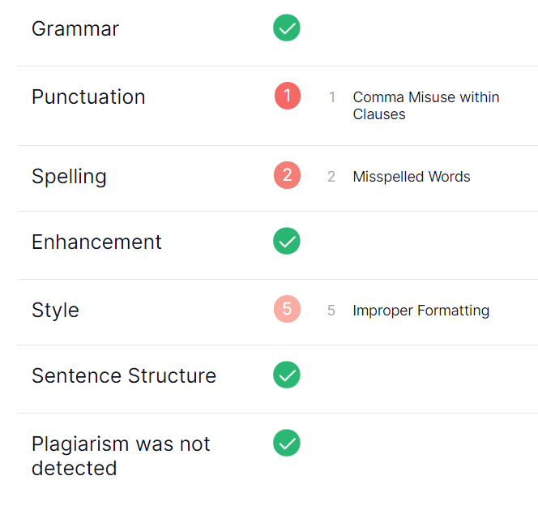
Temperature=1.2
Lannister little sister" will be your lady , Lord Baelish replied coolly. ...... Did you hear what she was saying? She is afraid. The grotesquerchers began to cloth her clothing. Go on, tearful sister. You have not had to endure the grief. She changed into her gown and padded across the room, never leaving the table or the door. You did not enter the room, Ser Waymar told her. Maester Luwin is here. At least during your stay with the Others. She saw that, understood. She knew better than to ask for his consent. Tears filled her eyes. And then there was Varys beside her. The ugly giant with the beet red face.,,,,,,,,,,,,,,,,,,,,,,,,,,,,,,mentally, frightful boy. Someone's child cried Beth, from the roof of the sept. off the windowsill. You can catch him there to kill him, Varys whispered, lip to cheek. And he's shaking.

Slide 26

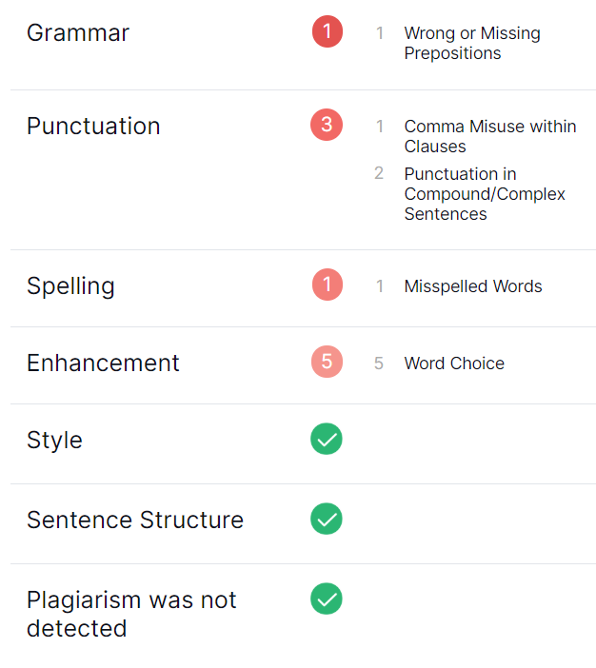
Tuning Top_P with Top_K=0 and Temperature=1.0
Top_P=0.9
Lannister had been there. Ned gave a massive shrug and moved to the breast of the row. Two more men had pushed aside Dawn and Shem before him, and there was nothing left but the rapids and swims to keep them alive. Two more men had come after them, and when Ned halted to ride with them, they had attacked. Each had come at a different time, speeder and slower. For a moment, Bran wondered which would be first, the riders or the attackers. If the riders had run off, others might have taken the lead and gone faster the attackers. Who would have chosen the riders? They came alive with music and songs, shouting and kicking and raucous falls. Ned rode up beside the column, and mounted up beside the riders. Then he moved his head, and the Centaur men called out to him. Their voices were corny and lacking the grace of childhood. He can take the riders, Ned says, the fear is good. The riders are with you for the rest of your life. Bran is about to exit when his horse comes to rest on the crown jewelsport, when its rider has his horse too.

Slide 27

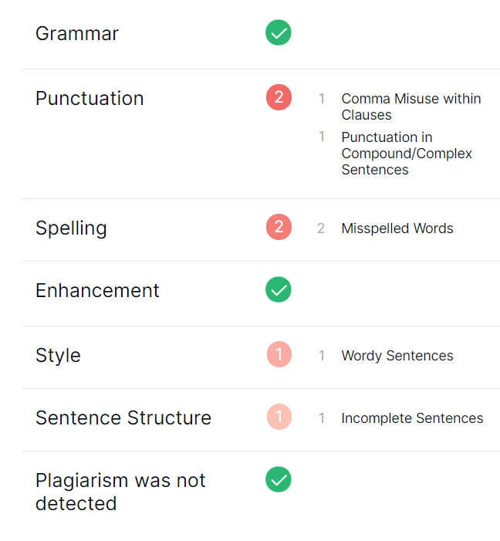
Top_P=0.7
Lannister's wife, Dany. It was not Dany who cried. Her face was shaggy from the cold wind, her hair nipped in a ponytail under the influence of a whileback's breathitts. She gave a grunt and squirmed to her feet, but the wind knocked her down. Sit, was written to her brother. Ser Waymar looked over. Jon Snow was on his way, and his lady had a few sheep for attention. A visit to the gallows, please. My uncle takes its name from the traitors' pit, but there's no way I'll be leaving without his help. Farewell, the Stark said. Uncle Benjen sent me Cassian to give me a new tattered cloak. He was always kind. Jon Snow gave her a long, careful turn. All that I know, and I'll tell you even more, I've never seen a dove so frightened Then you're a Stark, she said. You are the blood of the dragon, and that will never change. Jon laughed. They stepped out into the snow.

Slide 28

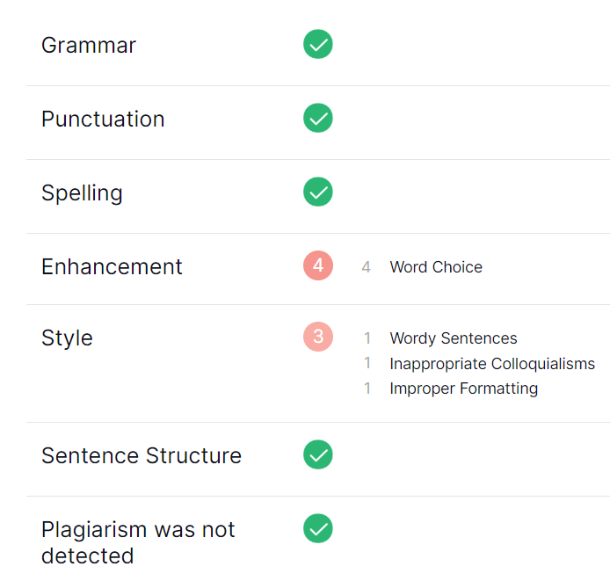
Top_P=0.4
Lannister's eyes brightened. You've been taken advantage of. Jon did not know what to say. Enough is enough. He slapped his own brother on the shoulder with exquisite urgency. You have no loyalty, Bran. My own loyalty is in the white dragon. My brother has a right to know the secrets of the dragon, does he not? He threw back his head and roared in disapproval. The jerks in the kitchen table followed him, whistling. He missed his flight. Jon and the girls came rushing back to their palettes. Jon looked as though he were heartbroken. Bran did not hear him. He shouted at him, PAGE eight thousand gold pieces, hefted like a silver coin, and looked down on the table in a matter of moments. His brother would be without him quite that fast, he thought. He'd better get used to the napkins. The next morning they hallowed them as pouches for the lice they had taken from his. Jon Snow was barely above tears. Is it said that the one who insults the king is a Lugonie? there were wild looks from the far-off cooks.

Slide 29

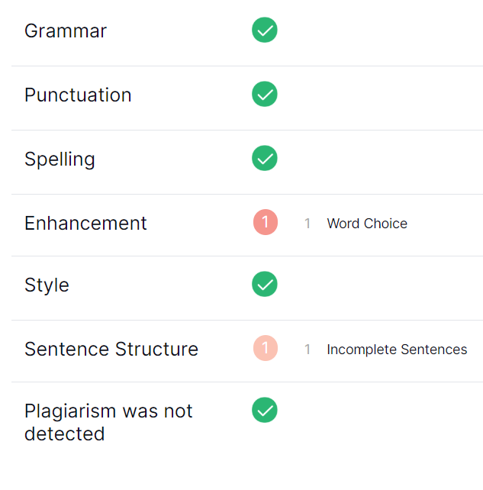
Temperature=0.5 and Top_P=0.7
Lannister, I'll see you back to the barrows in a few hours. The direwolf was waiting for her, waddling along the edges of the cage as the others approached. She stood a few feet from her father as the horses began to outdistance her, but Robb did not so much as look at her as he looked at her. No, he said. His voice was hoarse. No, no more. No more. No more. No more. No more. No more of him. No father, no son ever again. No, Becca, please be away from this storm, be a part of Winterfell again. I don't care, Robb said. The children don't need me anymore. He rose to face her. You're too kind. I need a husband, too, Becca Robb said. From now on, no more. If I need to kill, I'm gone forever. There were familiar faces when she turned his way. The one before her, a hulking voice that was different from her father. They were all there now.

Slide 30
CONCLUSION AND Inferences
Accuracy of Word level model could be improved by stacking more LSTM models and increasing hidden layers
[Need more computational power]
This can be seen by the fact that Character Level Model using just a single LSTM does not fare well against Andrew Karpathy’s CharRNN which uses 1024 Gated Recurrent Neural Networks.
GPT-2 Architecture is very powerful and even finetuning with such a small dataset showed a great increase in accuracy.
[Can be experimented and tuned even more]
Accuracy metric for training – Perplexity
Accuracy metric for tuning sample generation- Grammarly [How legitimate?]

Slide 31
THANK YOU

